Slide 1




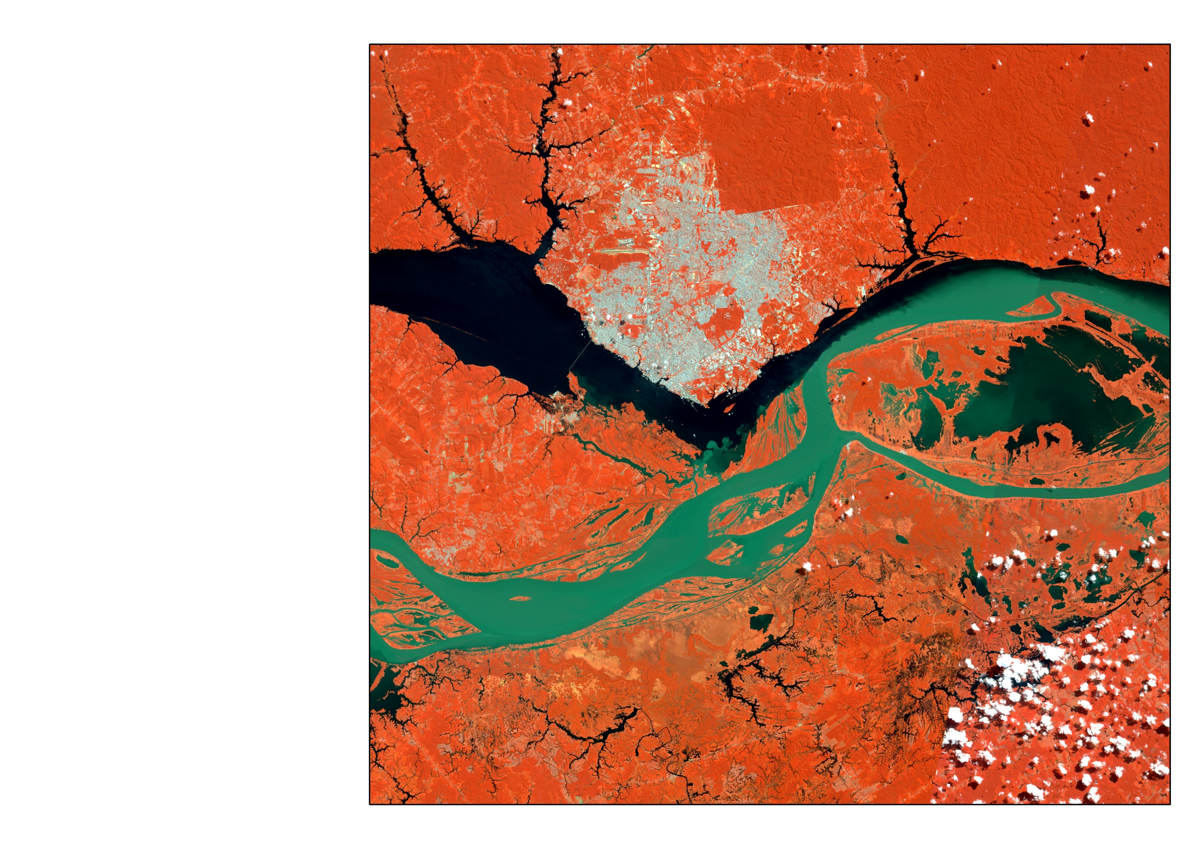
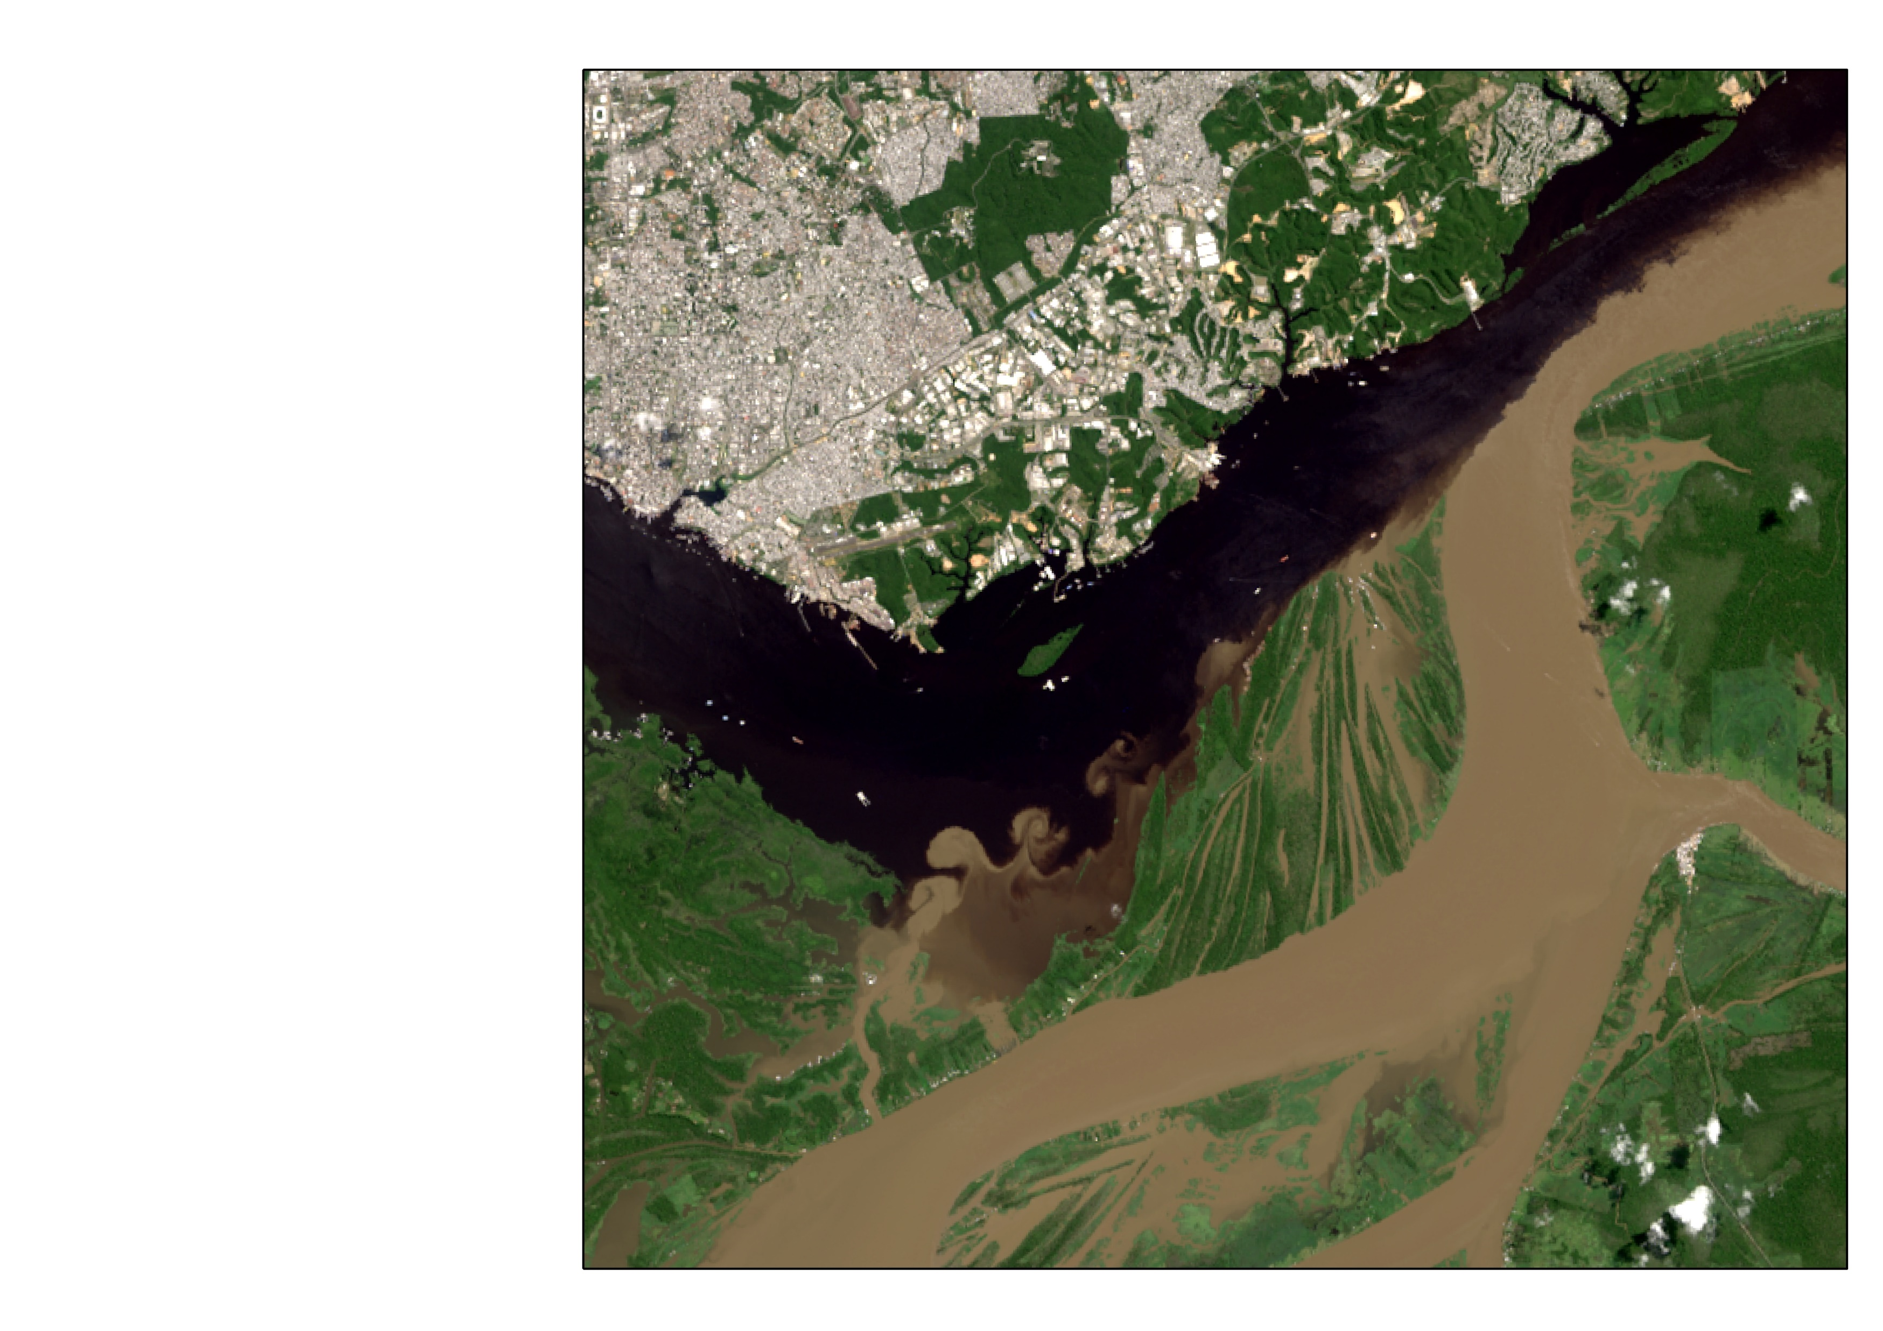
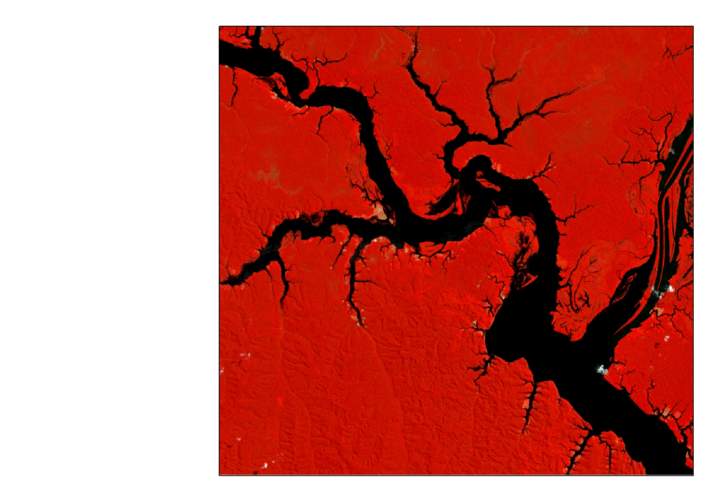
Water quality from space
Daniel Andrade Maciel

Slide 2
Pre-workshop preparations
Instructions for Google Earth Engine registration:
If you are not registered yet, you can join GEE: https://earthengine.google.com/new_signup/
Please, try to register before our workshop! It could take some days to Google approve your account.
Instructions for AQUASAT data download:
This data could be freely obtained from https://figshare.com/articles/dataset/AquaSat/8139383 Please, download it and save to your computer before the workshop.
Google Earth Engine Scripts that we will use:
Main script: https://code.earthengine.google.com/655c17969ba97f40b66ee46507d7cc88
Functions: https://code.earthengine.google.com/b86583b2c9d62761faabb122c3d7be2c

Slide 3
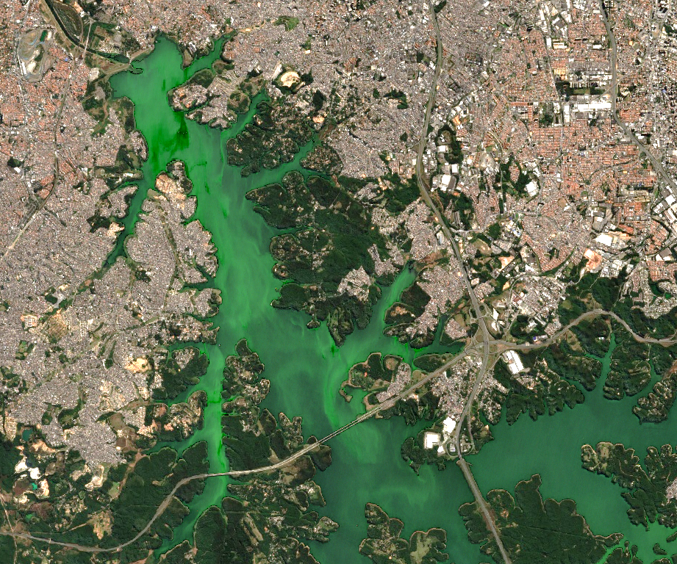
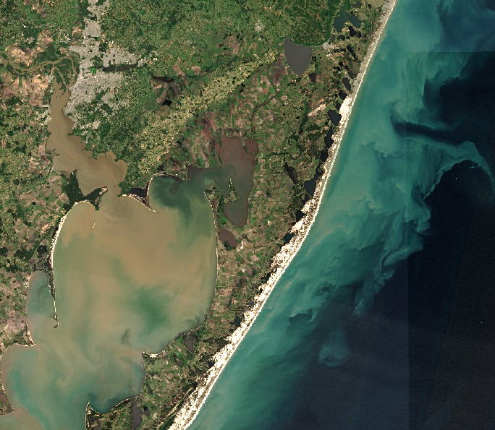
Billings Reservoir, Brazil
Patos Lagoon, Rio Grande do Sul, Brasil
Sensoriamento Remoto da cor da água
26 - 30 de Julho

Slide 4
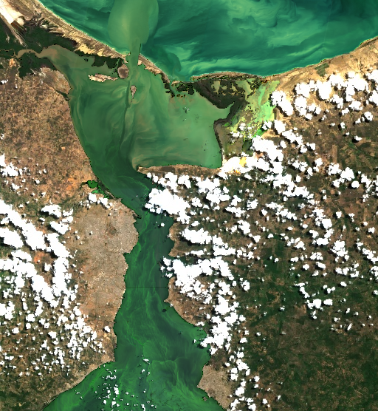
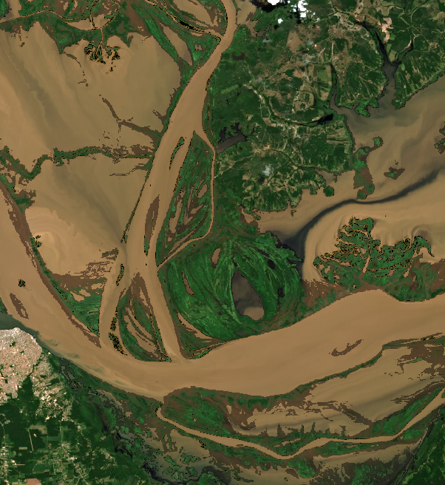
Maracaibo Lake, Venezuela
Amazon River, Brasil
Santarém
Sensoriamento Remoto da cor da água
26 - 30 de Julho

Slide 5
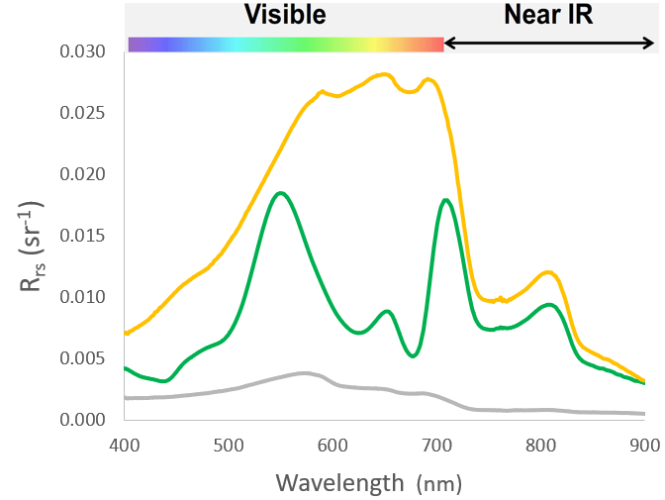
Particulado total
(TSM)
CDOM
phy
Total particulate
CDOM
Chl-a, TSS, aCDOM, Secchi, Kd, PC

Slide 6

$$Water Quality≈Remote Sensing$$

Slide 7
Algorithms
Empirical
Single Band
Semi-Analytical
Radiative transfer theory simplifications
Analytical
Radiative Transfer Theory
Machine Learning
Neural Networks
Band Ratio

Slide 8
Empirical Algorithms
Single Bands
This is a very good fit!!
Does not happen in real life
Sediment Concentraiton
Regression model
Y = ax + B
Reflectance (Red channel)

Slide 9
Collect water quality data and (ideally) remote sensing in-situ data
Try to collect these data close to satellite overpass
Create a database that relates in-situ water quality and remote sensing data
Obtain satellite data close to in-situ measured points
Develop an algorithm and validate it
Apply to satellite data!!
How to develop an empirical remote sensing algorithm for water quality?

Slide 10
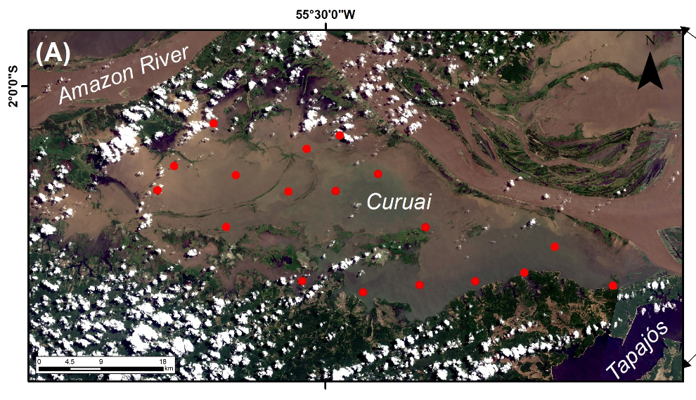

Slide 11
How to develop an empirical remote sensing algorithm for water quality?
blue | green | red | nir | secchi | tss | lat | long
0.007 | 0.008 | 0.007 | 0.012 | 5.6 | 3.83 | 45.5 | -67.8
0.006 | 0.007 | 0.004 | 0.008 | 9.1 | 4.1 | 45.5 | -67.8
0.017 | 0.016 | 0.012 | 0.020 | 5.6 | 3.3 | 45.5 | -67.8
0.009 | 0.009 | 0.007 | 0.012 | 3.1 | 3.7 | 45.6 | -67.6
0.005 | 0.004 | 0.003 | 0.007 | 6.7 | 2.8 | 45.6 | -67.6
0.012 | 0.013 | 0.012 | 0.021 | 8.7 | 4 | 45.6 | -67.6
0.006 | 0.006 | 0.004 | 0.008 | 0.14 | 3.5 | 45.6 | -67.6
0.005 | 0.005 | 0.003 | 0.005 | 1.3 | 5.5 | 45.6 | -67.6
0.008 | 0.009 | 0.008 | 0.011 | 5.6 | 6.15 | 45.6 | -67.6

Slide 12
How to develop an empirical remote sensing algorithm for water quality?
blue | green | red | nir | secchi | tss | lat | long
0.007 | 0.008 | 0.007 | 0.012 | 5.6 | 3.83 | 45.5 | -67.8
0.006 | 0.007 | 0.004 | 0.008 | 9.1 | 4.1 | 45.5 | -67.8
0.017 | 0.016 | 0.012 | 0.020 | 5.6 | 3.3 | 45.5 | -67.8
0.009 | 0.009 | 0.007 | 0.012 | 3.1 | 3.7 | 45.6 | -67.6
0.005 | 0.004 | 0.003 | 0.007 | 6.7 | 2.8 | 45.6 | -67.6
0.012 | 0.013 | 0.012 | 0.021 | 8.7 | 4 | 45.6 | -67.6
0.006 | 0.006 | 0.004 | 0.008 | 0.14 | 3.5 | 45.6 | -67.6
0.005 | 0.005 | 0.003 | 0.005 | 1.3 | 5.5 | 45.6 | -67.6
0.008 | 0.009 | 0.008 | 0.011 | 5.6 | 6.15 | 45.6 | -67.6

Slide 13
How to develop an empirical remote sensing algorithm for water quality?
blue | green | red | nir | secchi | tss | lat | long
0.007 | 0.008 | 0.007 | 0.012 | 5.6 | 3.83 | 45.5 | -67.8
0.006 | 0.007 | 0.004 | 0.008 | 9.1 | 4.1 | 45.5 | -67.8
0.017 | 0.016 | 0.012 | 0.020 | 5.6 | 3.3 | 45.5 | -67.8
0.009 | 0.009 | 0.007 | 0.012 | 3.1 | 3.7 | 45.6 | -67.6
0.005 | 0.004 | 0.003 | 0.007 | 6.7 | 2.8 | 45.6 | -67.6
0.012 | 0.013 | 0.012 | 0.021 | 8.7 | 4 | 45.6 | -67.6
0.006 | 0.006 | 0.004 | 0.008 | 0.14 | 3.5 | 45.6 | -67.6
0.005 | 0.005 | 0.003 | 0.005 | 1.3 | 5.5 | 45.6 | -67.6
0.008 | 0.009 | 0.008 | 0.011 | 5.6 | 6.15 | 45.6 | -67.6

Slide 14
How to develop an empirical remote sensing algorithm for water quality?
blue | green | red | nir | secchi | tss | lat | long
0.007 | 0.008 | 0.007 | 0.012 | 5.6 | 3.83 | 45.5 | -67.8
0.006 | 0.007 | 0.004 | 0.008 | 9.1 | 4.1 | 45.5 | -67.8
0.017 | 0.016 | 0.012 | 0.020 | 5.6 | 3.3 | 45.5 | -67.8
0.009 | 0.009 | 0.007 | 0.012 | 3.1 | 3.7 | 45.6 | -67.6
0.005 | 0.004 | 0.003 | 0.007 | 6.7 | 2.8 | 45.6 | -67.6
0.012 | 0.013 | 0.012 | 0.021 | 8.7 | 4 | 45.6 | -67.6
0.006 | 0.006 | 0.004 | 0.008 | 0.14 | 3.5 | 45.6 | -67.6
0.005 | 0.005 | 0.003 | 0.005 | 1.3 | 5.5 | 45.6 | -67.6
0.008 | 0.009 | 0.008 | 0.011 | 5.6 | 6.15 | 45.6 | -67.6

Slide 15
How to develop an empirical remote sensing algorithm for water quality?
blue | green | red | nir | secchi | tss | lat | long
0.007 | 0.008 | 0.007 | 0.012 | 5.6 | 3.83 | 45.5 | -67.8
0.006 | 0.007 | 0.004 | 0.008 | 9.1 | 4.1 | 45.5 | -67.8
0.017 | 0.016 | 0.012 | 0.020 | 5.6 | 3.3 | 45.5 | -67.8
0.009 | 0.009 | 0.007 | 0.012 | 3.1 | 3.7 | 45.6 | -67.6
0.005 | 0.004 | 0.003 | 0.007 | 6.7 | 2.8 | 45.6 | -67.6
0.012 | 0.013 | 0.012 | 0.021 | 8.7 | 4 | 45.6 | -67.6
0.006 | 0.006 | 0.004 | 0.008 | 0.14 | 3.5 | 45.6 | -67.6
0.005 | 0.005 | 0.003 | 0.005 | 1.3 | 5.5 | 45.6 | -67.6
0.008 | 0.009 | 0.008 | 0.011 | 5.6 | 6.15 | 45.6 | -67.6

Slide 16
How to develop an empirical remote sensing algorithm for water quality?
blue | green | red | nir | secchi | tss | lat | long
0.007 | 0.008 | 0.007 | 0.012 | 5.6 | 3.83 | 45.5 | -67.8
0.006 | 0.007 | 0.004 | 0.008 | 9.1 | 4.1 | 45.5 | -67.8
0.017 | 0.016 | 0.012 | 0.020 | 5.6 | 3.3 | 45.5 | -67.8
0.009 | 0.009 | 0.007 | 0.012 | 3.1 | 3.7 | 45.6 | -67.6
0.005 | 0.004 | 0.003 | 0.007 | 6.7 | 2.8 | 45.6 | -67.6
0.012 | 0.013 | 0.012 | 0.021 | 8.7 | 4 | 45.6 | -67.6
0.006 | 0.006 | 0.004 | 0.008 | 0.14 | 3.5 | 45.6 | -67.6
0.005 | 0.005 | 0.003 | 0.005 | 1.3 | 5.5 | 45.6 | -67.6
0.008 | 0.009 | 0.008 | 0.011 | 5.6 | 6.15 | 45.6 | -67.6
Sediment Concentraiton
Regression model
Y = ax + B
Reflectance (Red channel)

Slide 17
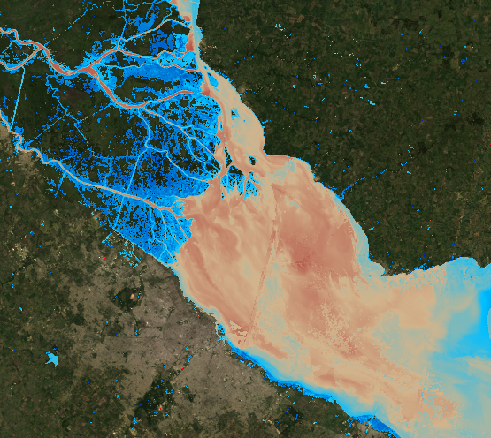
How to develop an empirical remote sensing algorithm for water quality?
Validation Metrics:
Error: 30%
R2: 0.92
BIAS: 10%
Sediment Concentraiton
Regression model
Y = ax + B
Reflectance (Red channel)

Slide 18
More resources
International Ocean Colour Coordinating Group (IOCCG):
In situ calibration/validation protocols [access here]​
Satellite missions
Task Force on Remote Sensing of Marine Litter and Debris
Earth Observations in Support of Global Water Quality Monitoring – Report
Educational Materials​
Optics webbook​
​GEO AquaWatch
Copernicus
Open Access Hub
Global Land Service
United States Geological Survey
Earth Explorer​
MISC Lab
Ocean Optics Classes
European Space Agency
Climate Change Initiative: Lakes​
Sentinel Application Platform (SNAP)
Earth Online
SNAP Toolboxes​
SNAP Tutorials
NASA Resources:
Applied Remote Sensing Training Program (ARSET)
Data visualization and analysis webtool
In situ ocean color network
Processing software
Upcoming ocean color mission
LabISA/INPE resources
Website
Introduction to Remote Sensing of Aquatic systems (Portuguese)

Slide 19
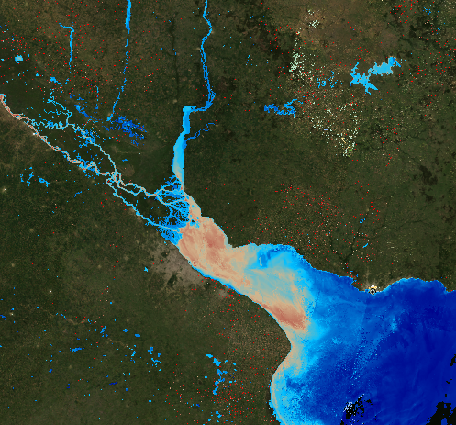
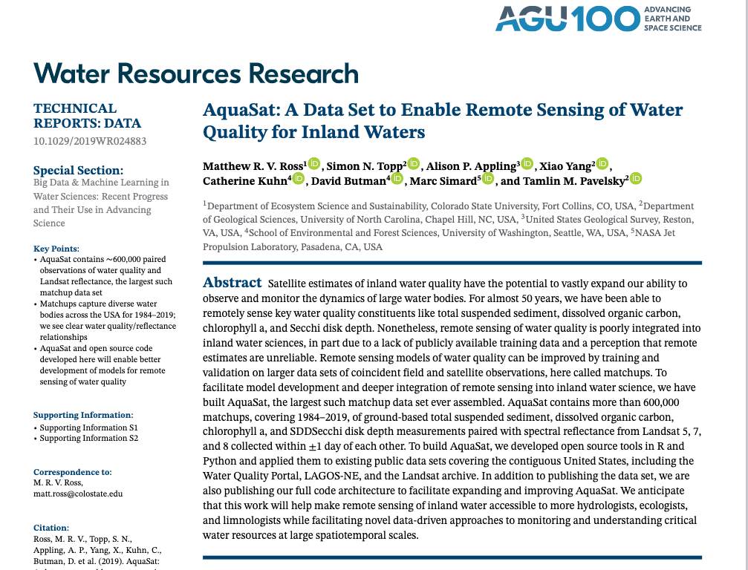
Hands on!!
Dataset used
Our Final results

